Slide 1
CPE 133
Mixed Logic
Experiment 7

Slide 2
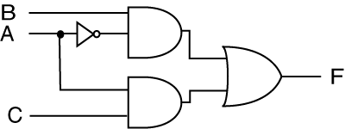

Mixed Logic
Problem: Implementing the “correct” functions in a mixed logic environment

Slide 3

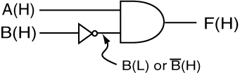
Mixed Logic
Based on which “state” causes an action
‘1’ action state: positive logic
‘0’ action state: negative logic
You’ve already worked with mixed logic

Slide 4


Mixed Logic Approach
Try not to use mixed logic…
if you have to, keep track of the logic levels
Use special indicators
Positive Logic Convention (PLC)
Direct Polarity Indicators (DPI)

Slide 5
Important Vernacular
“Asserted”
Not necessarily ‘1’ or ‘0’
Positive Logic
assertation level = high
asserted high
Active high
Negative logic
assertation level = low
asserted low
Active low

Slide 6
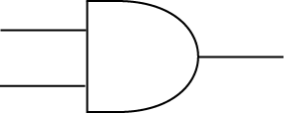
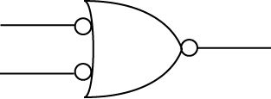
Design & Analysis Approach
Equivalent signals
Equivalent gates

Slide 7
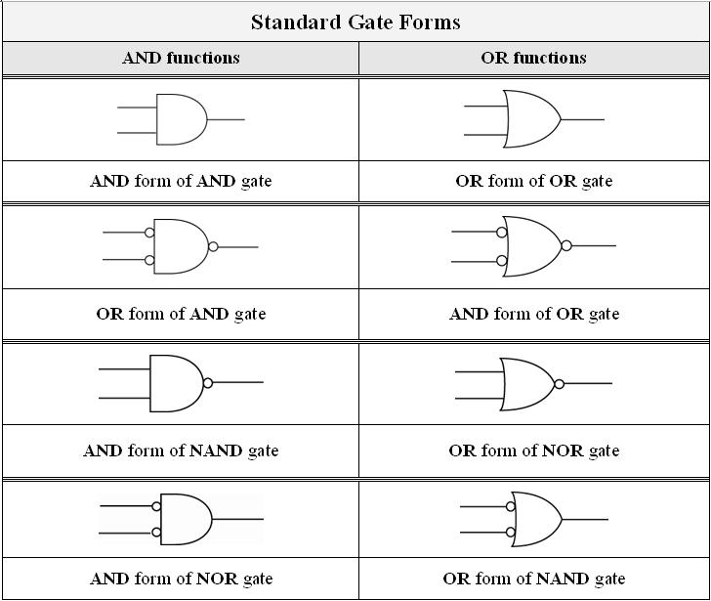
Equivalent Gates

Slide 8
Function Forms Revisited
Many different forms of functions
different forms use different gates
a few standard ones
Can be written in many ways…
If your gate performs an AND function
Use an AND form
If your gate performs an OR function,
Use an OR form

Slide 9
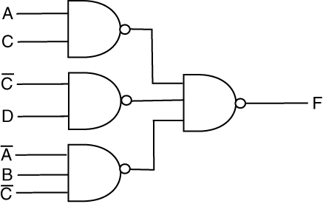
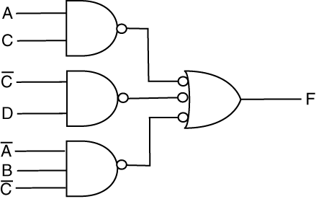
Good and Bad SOP Implementations
Sad
Happy

Slide 10
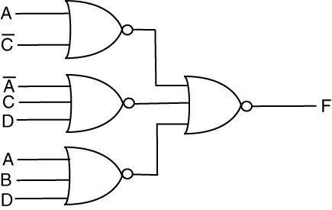
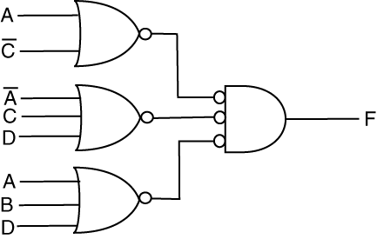
Good and Bad POS Implementations
Sad
Happy

Slide 11
The Approach To Mixed Logic
Analysis or Design
Use equivalent gates and equivalent signals where necessary in order to do what you need to do
We’ll use DPI (direct polarity indicators)

Slide 12

Mixed Logic Example
What function is being implemented if output is:
1) Active high
2) Active low

Slide 13
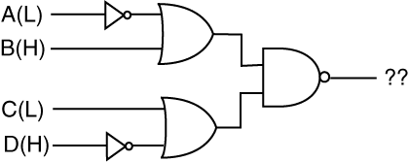
Mixed Logic Example
What function is being implemented if output is:
1) Active high
2) Active low

Slide 14
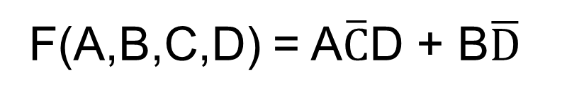
Mixed Logic Example
Design a circuit that implements the following function:
A and B inputs are asserted high
C and D & outputs are negative logic
Implement using any type of gates
F(A,B,C,D) = A$\overline{C}$D + B$\overline{D}$

Slide 15
Summary
Mixed logic circuit
Contains both negative and positive logic signals
Negative logic: asserted low (0 = action state)
Positive logic : asserted high (1 = action state)
Indicated with PLC or DPI
Keys to analysis:
Use equivalent signals & equivalent gates
Match logic levels

Slide 16
Experiment 7: Adder/Subtractor
5-bit Adder/Subtractor with validity detection
Inputs are in RC format
Don’t use high-level Verilog models
Provided modules
n-bit RCA & n-bit 2’s comp
univ_sseg.vhd
Simulate
Submit annotated timing diagram
Pick some meaningful test vectors
Don’t try to subtract -16

Slide 17
Experiment 7: Info
Start with block diagram
Use foundation modules
univ_sseg.v only understands unsigned binary
Use sign control input to output negative numbers
Draw top-level BBD
Do validity box example

